Slide 1
ME759 High Performance Computing for Applications in Engineering [Spring 2020]
Lecture 15
02/26/2019
Dan Negrut, 2020 ME759 UW-Madison

Slide 2
Quote of the day
“Roads are just a suggestion Marge, just like pants.”
-- Homer Simpson, Safety Inspector [1989 - ]

Slide 3
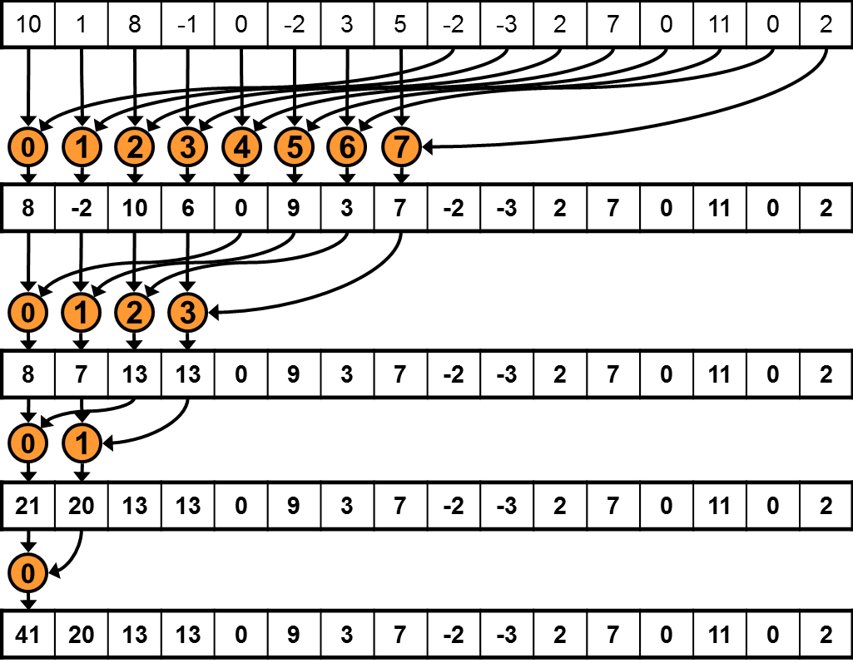
Before we get going…
Last time:
Rules of thumb, GPU computing optimization
Test case: reduction operation
Today:
Test case: scan operation
Quick overview, stencil op
CUDA streams (?)
Other tidbits:
Assignment due on Thursday at 9 pm
In my opinion, this and next are the toughest assignments of the semester
Assigned readings – don’t neglect them
Dan has office hours online each Wd@7 PM

Slide 4
CUDA Case Study: Parallel Prefix Scan on the GPU

Slide 5
Software Design Exercise: Parallel Prefix Scan
Implementation of prefix sum
Serial implementation – assigned as HW early in the semester
Parallel implementation: topic of next assignment
Goal 1: Getting additional exposure to CUDA programming and thinking that goes behind it
Goal 2: Understand that
Different algorithmic designs lead to different performance levels
Hardware constraints come into play in your applications and/or design solutions
Goal 3: Identify design patterns that can result in superior parallel performance
Understand that there are patterns and it’s worth being aware of them
To a large extend, patterns are shaped up by the underlying hardware
Notes:
DN: Patterns are the tricks of the trade

Slide 6
Parallel Prefix Sum (Scan)
Definition:
The all-prefix-sums operation takes a binary associative operator ⊕ with identity I, and an array of n elements
[a₀, a₁, …, a_{n-1}]
and returns the ordered set
[I, a₀, (a₀ ⊕ a₁), …, (a₀ ⊕ a₁ ⊕ … ⊕ a_{n-2})].
Example: If ⊕ is addition, then scan on the set
[3 1 7 0 4 1 6 3]
returns the set
[0 3 4 11 11 15 16 22]
Exclusive scan: last input element is not included in the result
(From Blelloch, 1990, “Prefix Sums and Their Applications)

Slide 7
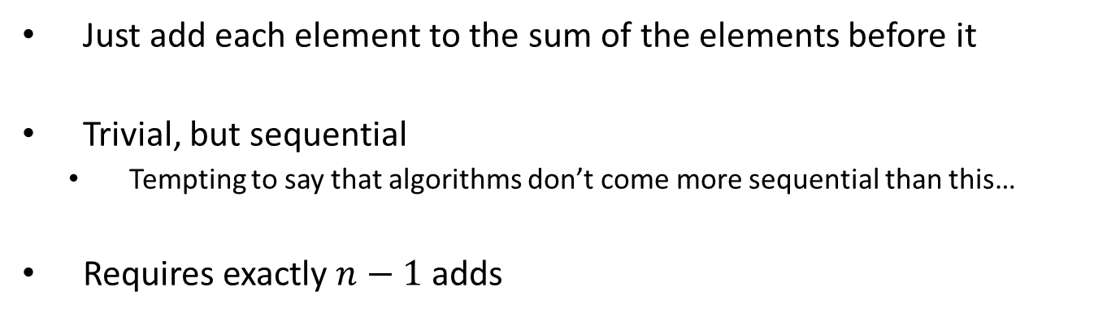
Scan on the CPU
void scan( float* scanned, float* input, int length)
{
scanned[0] = 0;
for(int i = 1; i < length; ++i)
{
scanned[i] = scanned[i-1] + input[i-1];
}
}
Just add each element to the sum of the elements before it
Trivial, but sequential
Tempting to say that algorithms don’t come more sequential than this…
Requires exactly $n−1$ adds
Notes:
(Dan): n-1 instead of n adds

Slide 8
Applications of Scan
Scan is a simple and useful parallel building block
Convert recurrences from sequential … out[0] = f(0)
for(j=1;j<n;j++) out[j] = out[j-1] + f(j);
… into parallel:
forall(j) in parallel
temp[j] = f(j); scan(out, temp);
Useful in implementation of several parallel algorithms:
Radix sort
Quicksort
String comparison
Lexical analysis
Stream compaction
Polynomial evaluation
Solving recurrences
Tree operations
Histograms
Etc.
HK-UIUC

Slide 9
Parallel Scan Algorithm Solution #1: Hillis & Steele (1986)
Implementation of the algorithm shown requires two buffers of length n (shown is the case n=8=2³)
Assumption: the number n of elements is a power of 2: n=2^{M}
NVIDIA [M. Harris]→

Slide 10
The Plain English Perspective
First iteration, I go with stride 1=2⁰
Start at x[2^{M}] and apply this stride to all the array elements before x[2^{M}] to find the mate of each of them. When looking for the mate, the stride should not land you before the beginning of the array. The sum replaces the element of higher index.
This means that I have 2^{M}- 2⁰ additions
Second iteration, I go with stride 2=2¹
Start at x[2^{M}] and apply this stride to all the array elements before x[2^{M}] to find the mate of each of them. When looking for the mate, the stride should not land you before the beginning of the array. The sum replaces the element of higher index.
This means that I have 2^{M} – 2¹ additions
Third iteration: I go with stride 4=2²
Start at x[2^{M}] and apply this stride to all the array elements before x[2^{M}] to find the mate of each of them. When looking for the mate, the stride should not land you before the beginning of the array. The sum replaces the element of higher index.
This means that I have 2^{M} – 2² additions
… (and so on)

Slide 11
The Plain English Perspective
Consider the k^{th} iteration (where 1<k<M-1): I go with stride 2^{k-1}
Start at x[2^{M}] and apply this stride to all the array elements before x[2^{M}] to find the mate of each of them. When looking for the mate, the stride should not land you before the beginning of the array. The sum replaces the element of higher index.
This means that I have 2^{M}-2^{k-1} additions
…
Mth iteration: I go with stride 2^{M-1}
Start at x[2^{M}] and apply this stride to all the array elements before x[2^{M}] to find the mate of each of them. When looking for the mate, the stride should not land you before the beginning of the array. The sum replaces the element of higher index.
This means that I have 2^{M}-2^{M-1} additions
NOTE: There is no (M+1)^{th} iteration since this would automatically put me beyond the bounds of the array (if you apply an offset of 2^{M} to “&x[2^{M}] ” it places you right before the beginning of the array – not good…)

Slide 12
Hillis & Steele Parallel Scan Algorithm
Algorithm looks like this:
for d := 0 to M-1 do
forall k do in parallel
if k – 2^{d} ≥0 then
x[out][k] := x[in][k] + x[in][k − 2^{d}]
else
x[out][k] := x[in][k]
endforall
swap(in,out)
endfor
Double-buffered version of the sum scan
NVIDIA [M. Harris]→

Slide 13
Hillis & Steele, Operation Count
The number of operations tally:
(2^{M}-2⁰) + (2^{M}-2¹) + … + (2^{M}-2^{k-1}) +…+ (2^{M}-2^{M-1})
Final operation count:
This is an algorithm with O(n*log(n)) work
Concluding remarks: is this approach good or not?
Sequential scan algorithm only needs n-1 additions
A factor of log₂(n) might hurt: 20x more work for 10⁶ elements!
Homework requires a scan of about 16 million elements
One more drawback: you need two buffers…
Notes:
DN: there was a bullet like this (not clear what it meant):
* A parallel algorithm can be slow when execution resources are saturated due to low algorithm efficiency

Slide 14
Hillis & Steele: Kernel Function
__global__ void scan(float *g_odata, float *g_idata, int n) {
extern volatile __shared__ float temp[]; // allocated on invocation
int thid = threadIdx.x;
int pout = 0, pin = 1;
// load input into shared memory.
// **exclusive** scan: shift right by one element and set first output to 0
temp[thid] = (thid == 0) ? 0: g_idata[thid-1];
__syncthreads();
for( int offset = 1; offset<n; offset *= 2 ) {
pout = 1 - pout; // swap double buffer indices
pin = 1 - pout;
if (thid >= offset)
temp[pout*n+thid] = temp[pin*n+thid] + temp[pin*n+thid - offset];
else
temp[pout*n+thid] = temp[pin*n+thid];
__syncthreads(); // I need this here before I start next iteration
}
g_odata[thid] = temp[pout*n+thid]; // write output
}

Slide 15
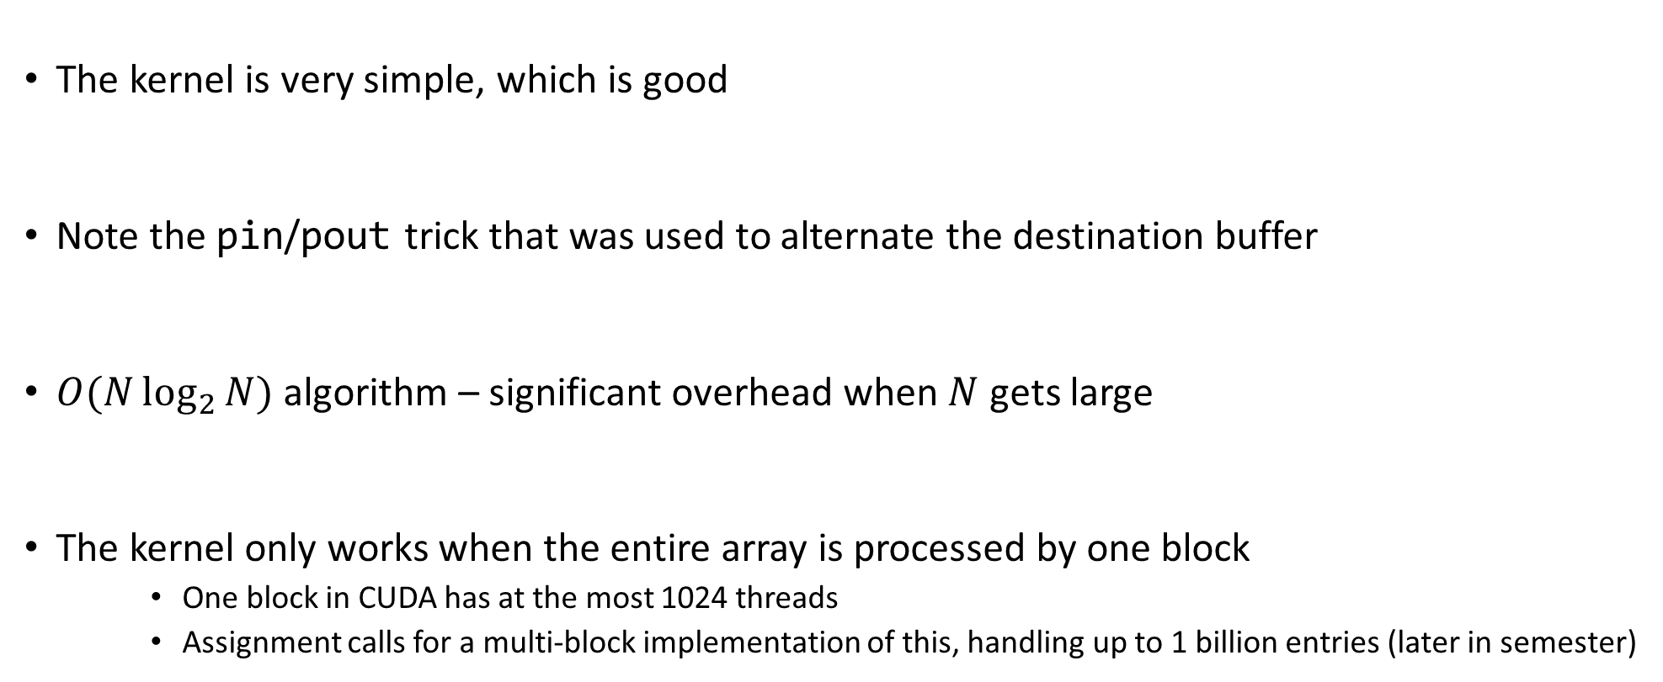
Hillis & Steele: Kernel Function, Quick Remarks
The kernel is very simple, which is good
Note the pin/pout trick that was used to alternate the destination buffer
$O(N\log_{2}{N})$ algorithm – significant overhead when $N$ gets large
The kernel only works when the entire array is processed by one block
One block in CUDA has at the most 1024 threads
Assignment calls for a multi-block implementation of this, handling up to 1 billion entries (later in semester)

Slide 16
Parallel Scan Algorithm: Solution #2: Harris-Sengupta-Owen (2007)
A common parallel algorithm pattern:
Balanced Trees
Build a balanced binary tree on the input data and sweep it to the root and then back into the leaves
Tree is not an actual data structure, but a concept to determine what each thread does at each step
For scan:
Traverse from leaves to root building partial sums at internal nodes in the tree
Root holds sum of all leaves → nice, this is a reduction algorithm
Traverse the tree back, from root to leaves, building the scan from the partial sums
Called down-sweep phase
16

Slide 17
Picture and Pseudocode: The Reduction Step (“leaves to root”)
j·2^{k+1}-1 =
1 3 5 7
3 7 -1 -1
7 -1 -1 -1
j·2^{k+1}-2^{k}-1 =
0 2 4 6
1 5 -1 -1
3 -1 -1 -1
for k=0 to M-1
offset = 2^{k}
for j=1 to 2^{M-k-1} do in parallel
x[j·2^{k+1}-1] = x[j·2^{k+1}-1] + x[j·2^{k+1}-2^{k}-1]
endfor
endfor
NOTE: “-1” entries
indicate no-ops
NVIDIA [M. Harris]→

Slide 18
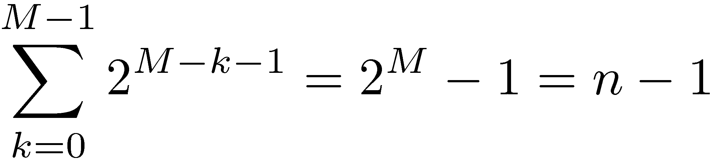
Operation Count, Reduce Phase
for k=0 to M-1
offset = 2^{k}
for j=1 to 2^{M-k-1} do in parallel
x[j·2^{k+1}-1] = x[j·2^{k+1}-1] + x[j·2^{k+1}-2^{k}-1]
endfor
endfor
By inspection:
Looks promising in terms of
operation count…

Slide 19
The “root-to-leaves” sweep
NOTE: This is just a mirror
image of the reduction
stage. Easy to come up with
the indexing scheme…
for k=M-1 to 0
offset = 2^{k}
for j=1 to 2^{M-k-1} do in parallel
dummy = x[j·2^{k+1}-2^{k}-1]
x[j·2^{k+1}-2^{k}-1] = x[j·2^{k+1}-1]
x[j·2^{k+1}-1] = x[j·2^{k+1}-1] + dummy
endfor
endfor
Set aside
Overwrite op.
Use
NVIDIA [M. Harris]→

Slide 20
Root-to-leaves phase, remarks
Number of operations for the down-sweep phase:
Additions: n-1
Overwrite ops. : n-1 (each overwrite shadows an addition)
Total number of operations associated with this algorithm
Additions: 2n-2
Overwrite ops: n-1
Looks comparable with the work load in the sequential solution
Convoluted algorithm, indexing tricky to figure out
Kernel shown on next slide

Slide 21
01| __global__ void prescan(float *g_odata, float *g_idata, int n)
02| {
03| extern volatile __shared__ float temp[];// allocated on invocation
04|
05|
06| int thid = threadIdx.x;
07| int offset = 1;
08|
09| temp[2*thid] = g_idata[2*thid]; // load input into shared memory
10| temp[2*thid+1] = g_idata[2*thid+1];
11|
12| for (int d = n>>1; d > 0; d >>= 1) // build sum in place up the tree
13| {
14| __syncthreads();
15|
16| if (thid < d) {
18| int ai = offset*(2*thid+1)-1;
19| int bi = offset*(2*thid+2)-1;
20|
21| temp[bi] += temp[ai];
22| }
23| offset <<= 1; //multiply by 2 implemented as bitwise operation
24| }
25|
26| if (thid == 0) { temp[n - 1] = 0; } // clear the last element
27|
28| for (int d = 1; d < n; d *= 2) // traverse down tree & build scan
29| {
30| offset >>= 1;
31| __syncthreads();
32|
33| if (thid < d)
34| {
35| int ai = offset*(2*thid+1)-1;
36| int bi = offset*(2*thid+2)-1;
37|
38| float t = temp[ai];
39| temp[ai] = temp[bi];
40| temp[bi] += t;
41| }
42| }
43|
44| __syncthreads();
45|
46| g_odata[2*thid] = temp[2*thid]; // write results to device memory
47| g_odata[2*thid+1] = temp[2*thid+1];
48| }
Argument list:
g_odata – pointer to output data, stored in device global memory
g_idata – pointer to input data, stored in device global memory
n – size of array on which prefix scan performed (assumed a power of 2)
NVIDIA [M. Harris]→

Slide 22
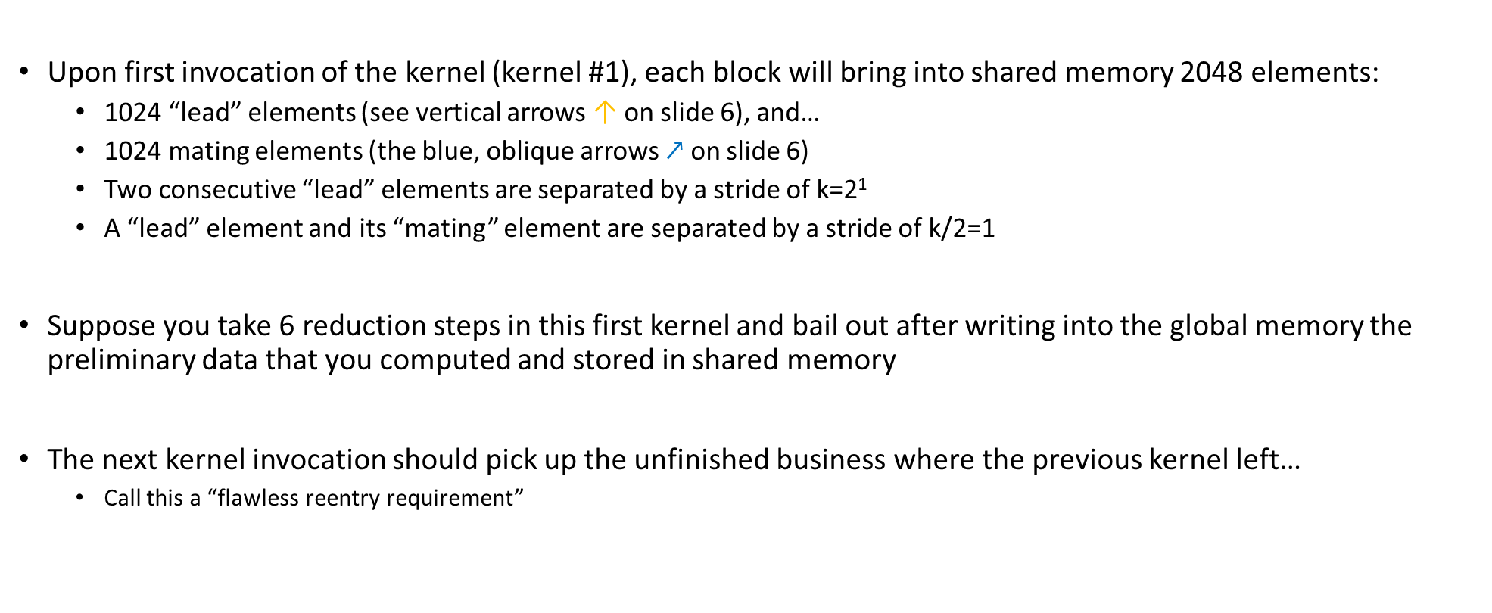
Going beyond 2048 entries handled by one CUDA block [1/3]
Upon first invocation of the kernel (kernel #1), each block will bring into shared memory 2048 elements:
1024 “lead” elements (see vertical arrows ↑ on slide 6), and…
1024 mating elements (the blue, oblique arrows $↗$ on slide 6)
Two consecutive “lead” elements are separated by a stride of k=2¹
A “lead” element and its “mating” element are separated by a stride of k/2=1
Suppose you take 6 reduction steps in this first kernel and bail out after writing into the global memory the preliminary data that you computed and stored in shared memory
The next kernel invocation should pick up the unfinished business where the previous kernel left…
Call this a “flawless reentry requirement”

Slide 23
Going beyond 2048 entries handled by one CUDA block [2/3]
Upon the second kernel call, each block will bring into shared memory 2048 elements:
1024 “lead” elements, and…
1024 “mating” elements
Two consecutive “lead” elements that you bring in will be separated in global memory by a stride of k=2⁶
A “lead” element and its “mating” element are separated by a stride of k/2=2⁵
Thus, when brining in data from global memory, you are not going to bring over a contiguous chunk of memory of size 2048, rather you’ll have to jump 2⁵ locations between successive “lead and mating element” pairs
However, once you bring data in shared memory, you process as before
Before you exit kernel #2 you have to write back data from shared memory into global memory
Again, you have to choreograph this shared to global memory store since there is a 2⁵ stride that comes into play
If you exit kernel #2 after say 4 more reduction steps, the next time you re-enter the kernel (#3) you will have k=2¹⁰

Slide 24
Going beyond 2048 entries handled by one CUDA block [3/3]
You will continue the reduction stage until the stride is 2^{M-1}
At this point you are ready to start the root-to-leaves sweep phase
“root-to-leaves” sweep phase carried out in a similar fashion: we will have to invoke the kernel several times
Always work in shared memory and copy back data to global memory before bailing out
The challenges here are:
Understanding the indexing into the global memory to bring data into ShMem
How to loop across the data in shared memory
Numerous shared memory bank conflicts since strides are powers of 2
Shared memory bank conflicts: discussed next
Advanced topic: get rid of the bank conflict through padding

Slide 25
Concluding Remarks, Parallel Scan
Intuitively, the scan operation is not the type of procedure ideally suited for parallel computing
Even if it doesn’t fit like a glove, leads to good speedup:
# elements | CPU Scan (ms) | GPU Scan (ms) | Speedup
1024 | 0.002231 | 0.079492 | 0.03
32768 | 0.072663 | 0.106159 | 0.68
65536 | 0.146326 | 0.137006 | 1.07
131072 | 0.726429 | 0.200257 | 3.63
262144 | 1.454742 | 0.326900 | 4.45
524288 | 2.911067 | 0.624104 | 4.66
1048576 | 5.900097 | 1.118091 | 5.28
2097152 | 11.848376 | 2.099666 | 5.64
4194304 | 23.835931 | 4.062923 | 5.87
8388688 | 47.390906 | 7.987311 | 5.93
16777216 | 94.794598 | 15.854781 | 5.98
Source: 2007 paper of Harris, Sengupta, Owens

Slide 26
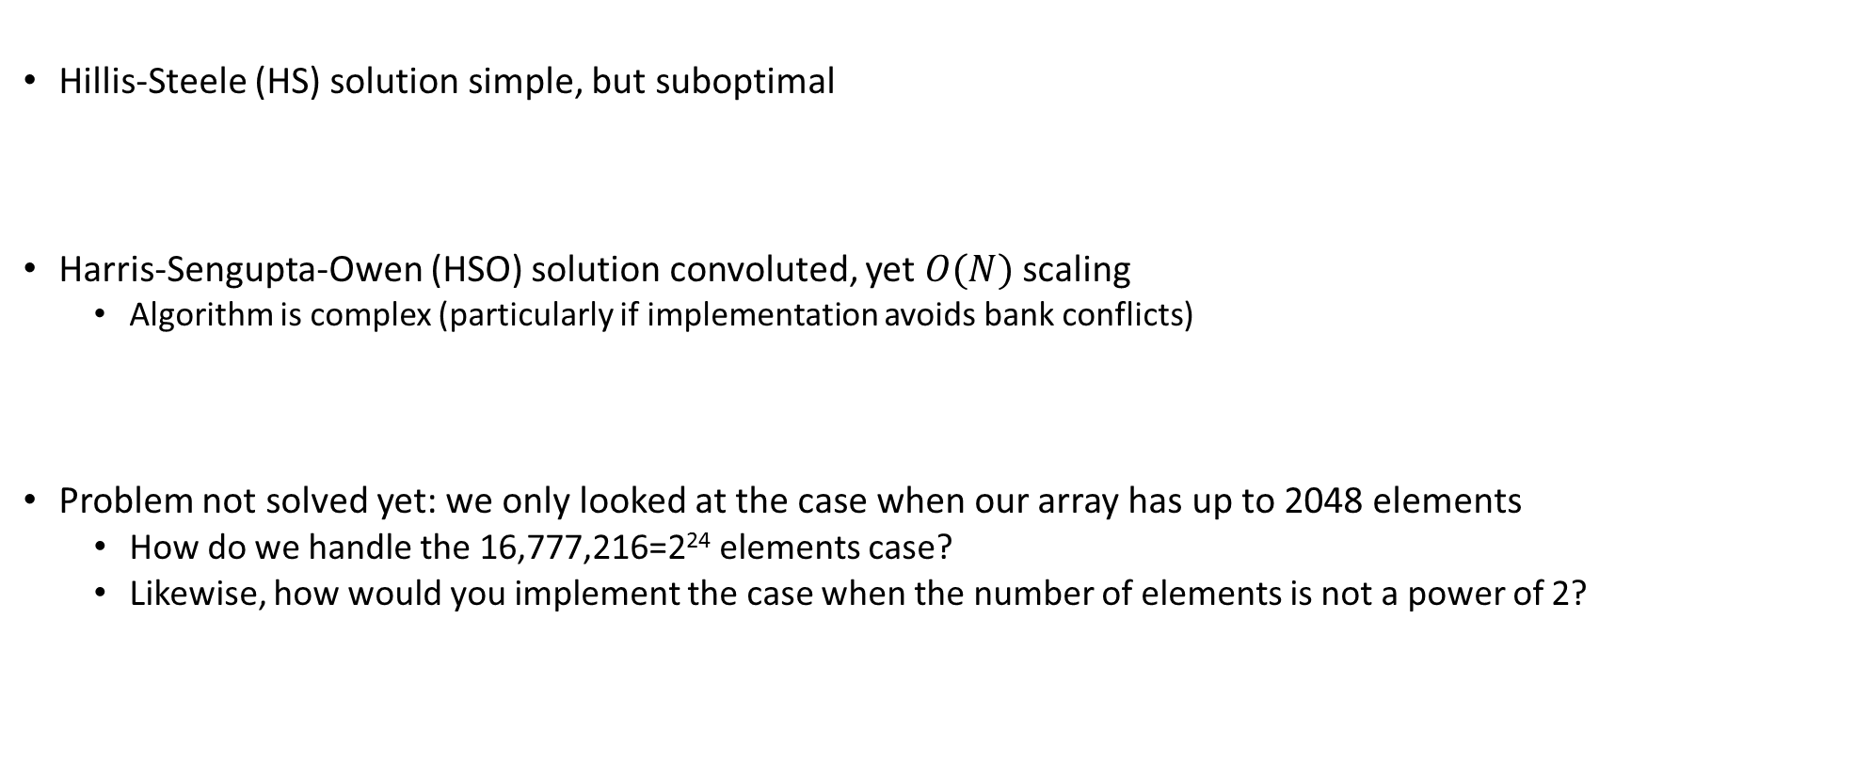
Concluding Remarks, Parallel Scan
Hillis-Steele (HS) solution simple, but suboptimal
Harris-Sengupta-Owen (HSO) solution convoluted, yet $O(N)$ scaling
Algorithm is complex (particularly if implementation avoids bank conflicts)
Problem not solved yet: we only looked at the case when our array has up to 2048 elements
How do we handle the 16,777,216=2²⁴ elements case?
Likewise, how would you implement the case when the number of elements is not a power of 2?

Slide 27
Case studies: Performing a 1D Stencil

Slide 28
Performing a 1D Stencil: problem setup
Applying a 1D stencil to a 1D array of elements
Function of input elements within a radius
Operation is fundamental to many algorithms
Standard discretization methods, interpolation, convolution, filtering, etc.
This example will use weighted arithmetic mean
radius
radius
NVIDIA [S. Satoor]→
Notes:
Now lets talk about a specific, realistic optimization example.

Slide 29
Serial Algorithm
= CPU Thread
(radius = 3)
in
…
…
f
out
…
…
NVIDIA [S. Satoor]→
Notes:
Describe how algorithm works from perspective of calculating each output element.

Slide 30
Serial Algorithm
= CPU Thread
(radius = 3)
…
…
in
f
out
…
…
…
Repeat for each element
NVIDIA [S. Satoor]→
Notes:
Serial, so thread moves from output-element to output-element.

Slide 31
Serial Implementation [assume N=16 mil.]
int main() {
int size = N * sizeof(float);
int wsize = (2 * RADIUS + 1) * sizeof(float);
//allocate resources
float *weights = (float *)malloc(wsize);
float *in = (float *)malloc(size);
float *out= (float *)malloc(size);
initializeWeights(weights, RADIUS);
initializeArray(in, N);
applyStencil1D(RADIUS,N-RADIUS,weights,in,out);
//free resources
free(weights); free(in); free(out);
}
void applyStencil1D(int sIdx, int eIdx, const float *weights, float *in, float *out) {
for (int i = sIdx; I < eIdx; i++) {
out[i] = 0;
//loop over all elements in the stencil
for (int j = -RADIUS; j <= RADIUS; j++) {
out[i] += weights[j + RADIUS] * in[i + j];
}
out[i] = out[i] / (2 * RADIUS + 1);
}
}
NVIDIA [S. Satoor]→
Notes:
Here’s a straight-forward implementation of the stencil algorithm in C.
RADIUS is relative small, 15 in this example.
N is large, 16 Melements

Slide 32
Serial Implementation
Allocate and initialize
int main() {
int size = N * sizeof(float);
int wsize = (2 * RADIUS + 1) * sizeof(float);
//allocate resources
float *weights = (float *)malloc(wsize);
float *in = (float *)malloc(size);
float *out= (float *)malloc(size);
initializeWeights(weights, RADIUS);
initializeArray(in, N);
applyStencil1D(RADIUS,N-RADIUS,weights,in,out);
//free resources
free(weights); free(in); free(out);
}
void applyStencil1D(int sIdx, int eIdx, const float *weights, float *in, float *out) {
for (int i = sIdx; I < eIdx; i++) {
out[i] = 0;
//loop over all elements in the stencil
for (int j = -RADIUS; j <= RADIUS; j++) {
out[i] += weights[j + RADIUS] * in[i + j];
}
out[i] = out[i] / (2 * RADIUS + 1);
}
}
Apply stencil
Cleanup
NVIDIA [S. Satoor]→

Slide 33
Serial Implementation
For each element…
int main() {
int size = N * sizeof(float);
int wsize = (2 * RADIUS + 1) * sizeof(float);
//allocate resources
float *weights = (float *)malloc(wsize);
float *in = (float *)malloc(size);
float *out= (float *)malloc(size);
initializeWeights(weights, RADIUS);
initializeArray(in, N);
applyStencil1D(RADIUS,N-RADIUS,weights,in,out);
//free resources
free(weights); free(in); free(out);
}
void applyStencil1D(int sIdx, int eIdx, const float *weights, float *in, float *out) {
for (int i = sIdx; I < eIdx; i++) {
out[i] = 0;
//loop over all elements in the stencil
for (int j = -RADIUS; j <= RADIUS; j++) {
out[i] += weights[j + RADIUS] * in[i + j];
}
out[i] = out[i] / (2 * RADIUS + 1);
}
}
Weighted mean over radius
NVIDIA [S. Satoor]→
Notes:
Because this is a serial implementation, note that we use a single thread to iterate over all output elements.

Slide 34
Serial Implementation
int main() {
int size = N * sizeof(float);
int wsize = (2 * RADIUS + 1) * sizeof(float);
//allocate resources
float *weights = (float *)malloc(wsize);
float *in = (float *)malloc(size);
float *out= (float *)malloc(size);
initializeWeights(weights, RADIUS);
initializeArray(in, N);
applyStencil1D(RADIUS,N-RADIUS,weights,in,out);
//free resources
free(weights); free(in); free(out);
}
void applyStencil1D(int sIdx, int eIdx, const float *weights, float *in, float *out) {
for (int i = sIdx; si < eIdx; i++) {
out[i] = 0;
//loop over all elements in the stencil
for (int j = -RADIUS; j <= RADIUS; j++) {
out[i] += weights[j + RADIUS] * in[i + j];
}
out[i] = out[i] / (2 * RADIUS + 1);
}
}
CPU | MElements/s
i7-930 | 30
NVIDIA [S. Satoor]→
Notes:
Because this is a serial implementation, note that we use a single thread to iterate over all output elements.

Slide 35
Application Optimization Process
Identify Optimization Opportunities
1D stencil algorithm
Parallelize with CUDA and confirm functional correctness
cuda-gdb, cuda-memcheck
Note: cuda-memcheck useful for memory debugging
Out of bounds accesses
Accessing misaligned data
Race conditions
Memory leaks
Optimize
…dealing with this next, using nvvp
NVIDIA [S. Satoor]→
Notes:
Application optimization process: we identified and parallelized
Used CUDA to expose parallelism
Used memory checking, debugging tools to get functional correctness
What about optimize?

Slide 36
Parallel Algorithm
= Thread
in
Serial: One element at a time
…
…
…
…
out
in
Parallel: Many elements at a time
…
…
…
…
out
…
…
NVIDIA [S. Satoor]→
Notes:
This algorithm can be parallelized. Calculation of each output element is independent of others, so we can have multiple threads working in parallel. Each thread calculates a different output element value.

Slide 37
The Parallel Implementation
void main() {
int size = N * sizeof(float);
int wsize = (2 * RADIUS + 1) * sizeof(float);
//allocate resources
float *weights = (float *)malloc(wsize);
float *in = (float *)malloc(size);
float *out= (float *)malloc(size);
initializeWeights(weights, RADIUS);
initializeArray(in, N);
float *d_weights; cudaMalloc(&d_weights, wsize);
float *d_in; cudaMalloc(&d_in, size);
float *d_out; cudaMalloc(&d_out, size);
cudaMemcpy(d_weights,weights,wsize,cudaMemcpyHostToDevice);
cudaMemcpy(d_in, in, size, cudaMemcpyHostToDevice);
applyStencil1D<<<N/512, 512>>>(RADIUS, N-RADIUS, d_weights, d_in, d_out);
cudaMemcpy(out, d_out, size, cudaMemcpyDeviceToHost);
//free resources
free(weights); free(in); free(out);
cudaFree(d_weights); cudaFree(d_in); cudaFree(d_out);
}
The GPU kernel
__global__ void applyStencil1D(int sIdx, int eIdx, const float *weights, float *in, float *out) {
int i = sIdx + blockIdx.x*blockDim.x + threadIdx.x;
if( i < eIdx ) {
out[i] = 0;
//loop over all elements in the stencil
for (int j = -RADIUS; j <= RADIUS; j++) {
out[i] += weights[j + RADIUS] * in[i + j];
}
out[i] = out[i] / (2 * RADIUS + 1);
}
}
NVIDIA [S. Satoor]→

Slide 38
The Parallel Implementation
void main() {
int size = N * sizeof(float);
int wsize = (2 * RADIUS + 1) * sizeof(float);
//allocate resources
float *weights = (float *)malloc(wsize);
float *in = (float *)malloc(size);
float *out= (float *)malloc(size);
initializeWeights(weights, RADIUS);
initializeArray(in, N);
float *d_weights; cudaMalloc(&d_weights, wsize);
float *d_in; cudaMalloc(&d_in, size);
float *d_out; cudaMalloc(&d_out, size);
cudaMemcpy(d_weights,weights,wsize,cudaMemcpyHostToDevice);
cudaMemcpy(d_in, in, size, cudaMemcpyHostToDevice);
applyStencil1D<<<N/512, 512>>>(RADIUS, N-RADIUS, d_weights, d_in, d_out);
cudaMemcpy(out, d_out, size, cudaMemcpyDeviceToHost);
//free resources
free(weights); free(in); free(out);
cudaFree(d_weights); cudaFree(d_in); cudaFree(d_out);
}
Device | Algorithm | MElements/s | Speedup
i7-930* | Optimized & Parallel | 130 | 1x
Tesla C2075 | Simple | 285 | 2.2x
__global__ void applyStencil1D(int sIdx, int eIdx, const float *weights, float *in, float *out) {
int i = sIdx + blockIdx.x*blockDim.x + threadIdx.x;
if( i < eIdx ) {
out[i] = 0;
//loop over all elements in the stencil
for (int j = -RADIUS; j <= RADIUS; j++) {
out[i] += weights[j + RADIUS] * in[i + j];
}
out[i] = out[i] / (2 * RADIUS + 1);
}
}
NVIDIA [S. Satoor]→

Slide 39
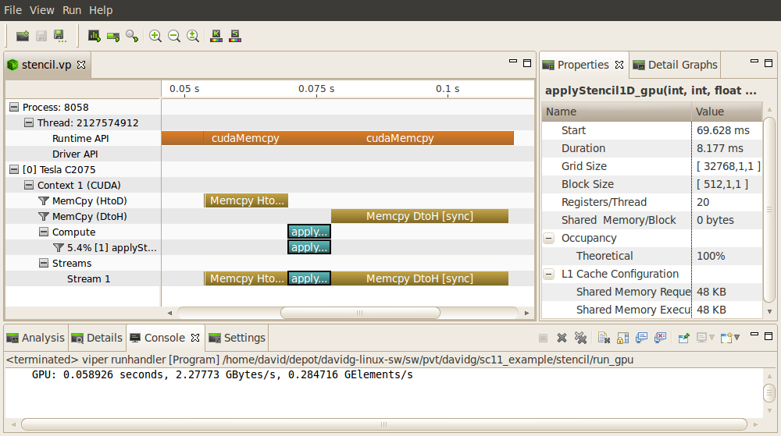
NVIDIA Visual Profiler
CUDA API activity on CPU
The interesting part, done on the GPU
Memcpy and kernel activity on GPU
NVIDIA [S. Satoor]→
Notes:
General layout… timeline for visualization plus additional information…
Timeline shows GPU and CPU activity
Additional information available for kernels and memcpys

Slide 40
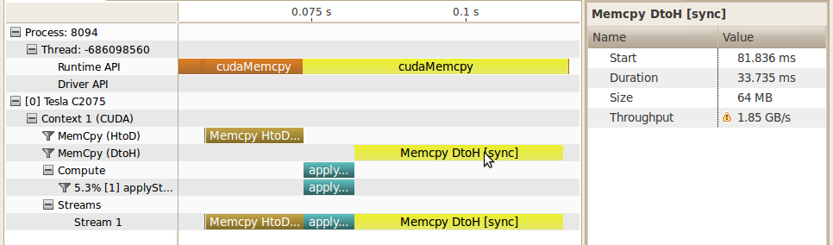
Quiz: Why is CPU thread shown with two contiguous cudaMemcpy?
Why contiguous on the CPU side?
Notes:
From timeline we can easily see that majority of time for stencil algorithm is spent moving data to and from GPU
By looking at the memcpy details we see that BW is quite low…
Note that VP highlights the problem with ! indication

Slide 41
Detecting Low Memory Throughput
Spent majority of time in data transfer
Often can be overlapped with preceding or following computation
From timeline can see that throughput is low
PCIe x16 can sustain significantly more than this
NVIDIA [S. Satoor]→
Notes:
From timeline we can easily see that majority of time for stencil algorithm is spent moving data to and from GPU
By looking at the memcpy details we see that BW is quite low…
Note that VP highlights the problem with ! indication

Slide 42
Visual Profiler Analysis
How do we know when there is an optimization opportunity?
Timeline visualization seems to indicate an opportunity
Documentation gives guidance and strategies for tuning
CUDA Best Practices Guide
CUDA Programming Guide
Visual Profiler analyzes your application
Uses timeline and other collected information
Highlights specific guidance from Best Practices
Like having a customized Best Practices Guide for your application
NVIDIA [S. Satoor]→
Notes:
What if not a PCIe expert… can see that memcpy is taking a lot of time but how do we know if that is an opportunity for optimization or not?

Slide 43
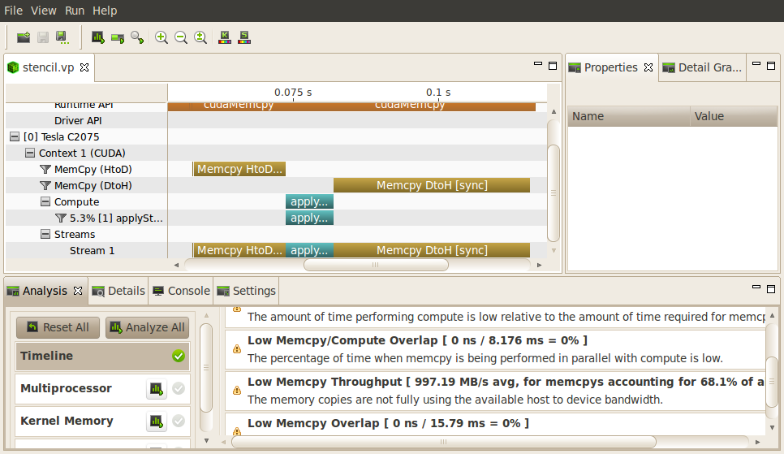
Visual Profiler Analysis
Analysis pointing out low memcpy throughput
Several types of analysis are provided
NVIDIA [S. Satoor]→
Notes:
Transition… accessing the analysis portion of visual profiler is easy. Simply click one button and vp will collect the necessary information to perform the analysis and then present the results.

Slide 44
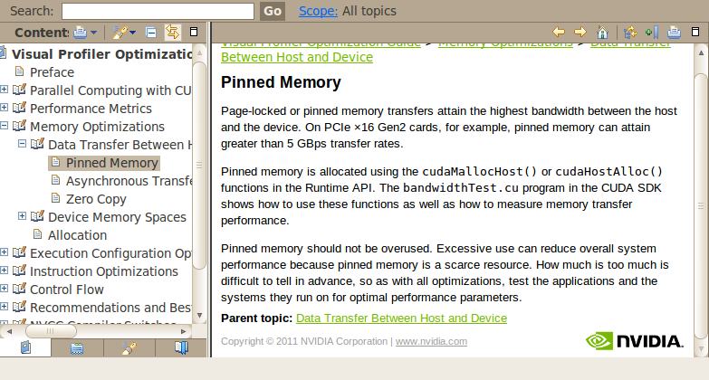
Online Optimization Help
Each analysis has link to Best Practices documentation
NVIDIA [S. Satoor]→
Notes:
Best practices information is included, online in the visual profiler
Each result has link to get more details Best Practices information…

Slide 45
Pinned CPU Memory Implementation
int main() {
int size = N * sizeof(float);
int wsize = (2 * RADIUS + 1) * sizeof(float);
//allocate resources
float *weights; cudaMallocHost(&weights, wsize);
float *in; cudaMallocHost(&in, size);
float *out; cudaMallocHost(&out, size);
initializeWeights(weights, RADIUS);
initializeArray(in, N);
float *d_weights; cudaMalloc(&d_weights);
float *d_in; cudaMalloc(&d_in);
float *d_out; cudaMalloc(&d_out);
…
CPU allocations use pinned memory to enable fast memcpy
No other changes
NVIDIA [S. Satoor]→
Notes:
Spend some time reading best practices, understanding some additional CUDA features… and we learn that pinned memory can significantly increase memcpy BW
Also learn what code modification is needed… very simple in this case

Slide 46
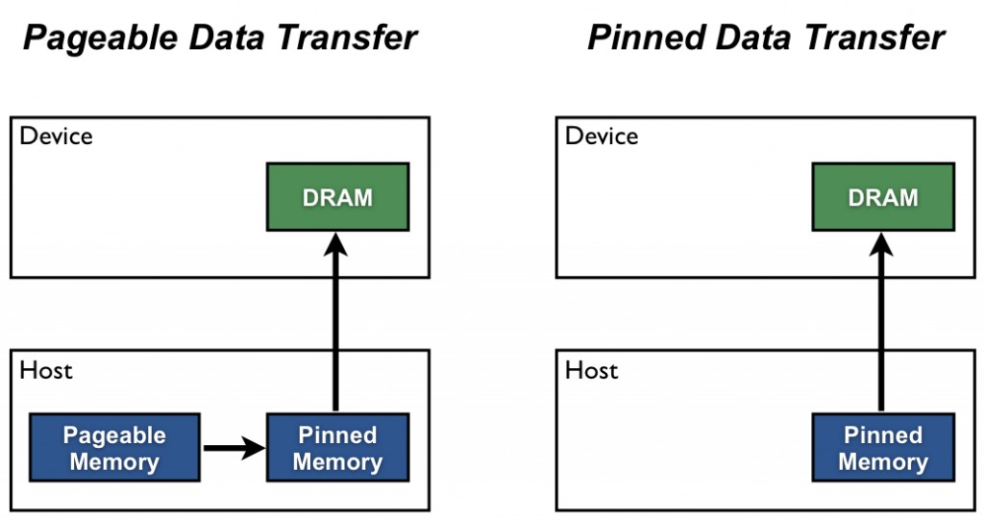
CUDA: Pageable vs. Pinned Data Transfer

Slide 47

Pinned Memory
DMA (direct memory access) uses physical addresses
The OS could accidentally page out the data that is being read or written by a DMA and page in another virtual page into the same location
Pinned memory cannot not be paged out
If a source or destination of a cudaMemCpy() in the host memory is not pinned, it needs to be first copied to a pinned memory – extra overhead
cudaMemcpy faster with pinned host memory source or destination

Slide 48
Allocate/Free Pinned Memory (a.k.a. Page Locked Memory)
cudaHostAlloc()
Three parameters
Address of pointer to the allocated memory
Size of the allocated memory in bytes
Option – use cudaHostAllocDefault for now
cudaFreeHost()
One parameter
Pointer to the memory to be freed

Slide 49
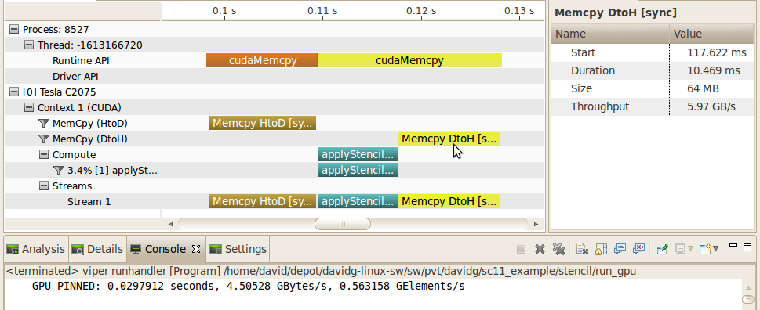
Pinned CPU Memory Result
NVIDIA [S. Satoor]→
Notes:
Can see that portion of overall time required by memcpy is significantly reduced
Details also show that BW is now much higher (from < 2GB/s to almost 6GB/s)… other memcpy is similar (going from < 4GB/s to almost 6GB/s)

Slide 50
Pinned CPU Memory Result
Device | Algorithm | MElements/s | Speedup
i7-930* | Optimized & Parallel | 130 | 1x
Tesla C2075 | Simple | 285 | 2.2x
Tesla C2075 | Pinned Memory | 560 | 4.3x
NVIDIA [S. Satoor]→
Notes:
Can see that portion of overall time required by memcpy is significantly reduced
Details also show that BW is now much higher (from < 2GB/s to almost 6GB/s)… other memcpy is similar (going from < 4GB/s to almost 6GB/s)

Slide 51

Application Optimization Process [Revisited]
Identify Optimization Opportunities
1D stencil algorithm
Parallelize with CUDA, confirm functional correctness
Debugger
Memory Checker
Optimize
Profiler (pinned memory)
NVIDIA [S. Satoor]→
Notes:
Complete entire optimization process? Can we do more… of course

Slide 52
Application Optimization Process [Revisited]
Identify Optimization Opportunities
1D stencil algorithm
Parallelize with CUDA, confirm functional correctness
Debugger
Memory Checker
Optimize
Profiler (pinned memory)
NVIDIA [S. Satoor]→
Notes:
Iterate optimization step to see if there are more opportunities…

Slide 53
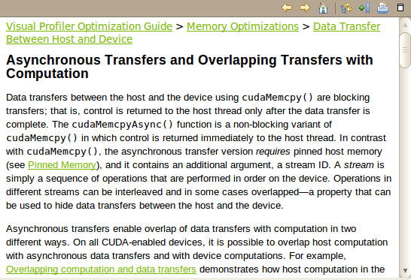
Advanced optimization
Larger time investment
Potential for larger speedup
NVIDIA [S. Satoor]→
Notes:
More advanced optimization if you want to spend more time
Chunking is similar to partitioning data on a multi-core CPU, so that each core works on a different part of the problem
Visual profiler analysis identifies this opportunity and points to best practices details…

Slide 54
Data Partitioning Example
Partition data into TWO chunks
chunk 1
chunk 2
On the CPU
in
On the CPU
out
NVIDIA [S. Satoor]→

Slide 55
Data Partitioning Example
On the CPU
chunk 1
chunk 2
in
memcpy
compute
memcpy
On the GPU
On the CPU
out
NVIDIA [S. Satoor]→

Slide 56
Data Partitioning Example
On the CPU
chunk 1
chunk 2
in
memcpy
compute
memcpy
On the GPU
memcpy
compute
memcpy
On the CPU
out
NVIDIA [S. Satoor]→

Slide 57
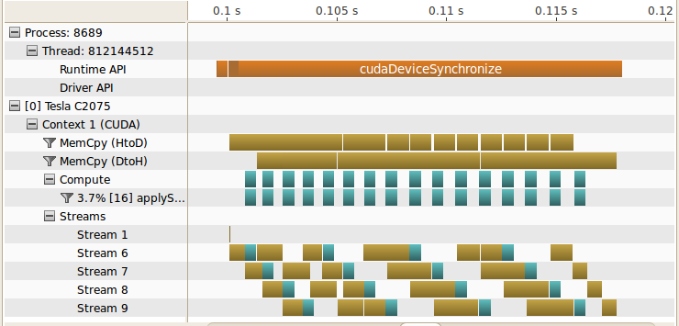
Overlapped Compute/Memcpy [problem broken into 16 chunks]
NVIDIA [S. Satoor]→
Notes:
Broke stencil problem into 16 chunks
Show in->compute->out for each chunk
Streams are a way to represent different groups of work that are independent

Slide 58
Overlapped Compute/Memcpy
Exploit dual memcpy engines
Compute time completely “hidden”
ME759: Use of multiple streams covered later
NVIDIA [S. Satoor]→
Notes:
Broke stencil problem into 16 chunks
Show in->compute->out for each chunk
Streams are a way to represent different groups of work that are independent

Slide 59
Overlapped Compute/Memcpy
Device | Algorithm | MElements/s | Speedup
i7-930* | Optimized & Parallel | 130 | 1x
Tesla C2075 | Simple | 285 | 2.2x
Tesla C2075 | Pinned Memory | 560 | 4.3x
Tesla C2075 | Overlap | 935 | 7.2x
NVIDIA [S. Satoor]→

Slide 60
Optimization Summary [Looking Back at 1D Stencil Example…]
Initial CUDA parallelization
Expeditious, kernel almost word-for-word replica of sequential code
2.2x speedup
Optimize memory throughput
Minimal code change, yet need to know about pinned memory
4.3x speedup
Overlap compute and data movement
More involved, need to know about the inner works of CUDA
Problem should be large enough to justify mem-transfer/execution
7.2x speedup

Slide 61
Iterative Optimization
Identify Optimization Opportunities
Parallelize
Optimize
NVIDIA [S. Satoor]→
Notes:
But that doesn’t mean no additional speedup is possible…
Can iterate entire process to find new function/algorithm that can be optimized.

Slide 62
CUDA Streams

Slide 63
Read this blog post: https://devblogs.nvidia.com/parallelforall/gpu-pro-tip-cuda-7-streams-simplify-concurrency

Slide 64
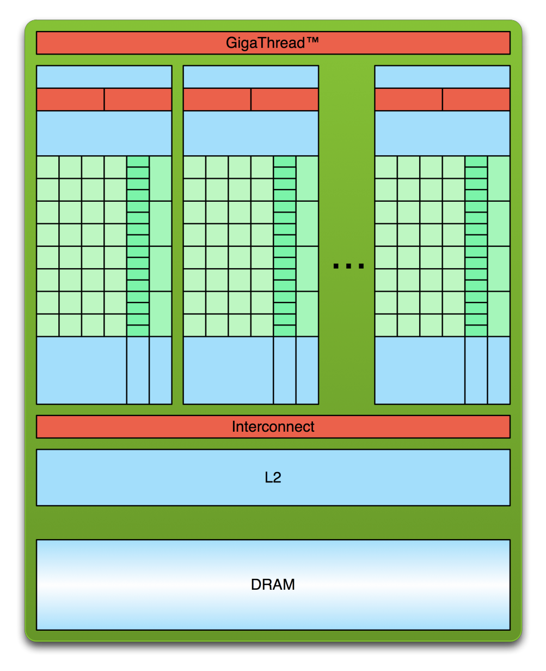
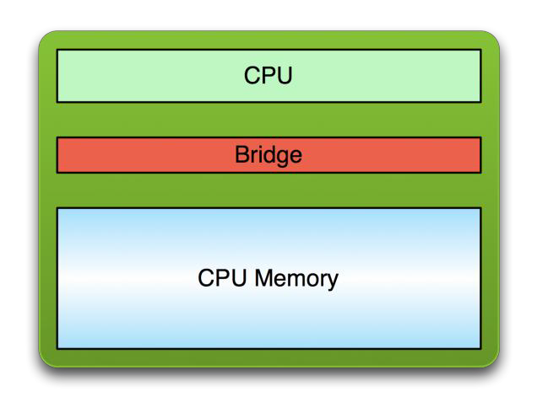
The “GPU computing” process
PCI Bus
Copy input data from CPU memory to GPU memory
Launch a GPU Kernel
Copy results from GPU memory to CPU memory
Repeat Many Times
[Justin Luitjens - NVIDIA]$→$

Slide 65
CUDA Streams: Prelude
A CUDA enabled GPU has two engines
An execution engine
A copy engine, which has 2 sub-engines that can work simultaneously
A H2D copy sub-engine
A D2H copy sub-engine
Goal of the “streams” segment of ME759: Learn how to simultaneously use both GPU engines
NOTE (in relation to this “streams” segment of the course):
The important things happen on the host side, not on the device side

Slide 66
[“Streams” Preamble: 1/3] Asynchronous Concurrent Execution
In order to facilitate concurrent execution on host and device, some function calls are asynchronous
Control is returned to the host thread before the device has completed the requested task
Examples of asynchronous calls
Kernel launches
device ↔ device memory copies
host ↔ device memory copies of a memory block of 64 KB or less
Memory copies performed by functions that are suffixed with Async (e.g., cudaMemcpyAsync)
NOTE: When an application is run via a (cuda-gdb, nvprof), all launches are synchronous

Slide 67
[“Streams” Preamble: 2/3] Non-blocking Host-Device Data Transfer Issues
In general, host ↔ device data transfers using cudaMemcpy() are blocking
Control is returned to the host thread only after the data transfer is complete
There is a non-blocking variant, cudaMemcpyAsync()
The host does not wait on the device to finish the mem copy or on the completion of the kernel call for it to start execution of the cpuFunction() call
The launch of “myKernel” only happens after the mem copy call finishes
NOTE: the asynchronous transfer version requires pinned host memory (allocated with cudaHostAlloc()), and it contains an additional argument (a stream ID)
The cudaHosAlloc() replaces malloc() typical call on the host side
What does this buy us?
We have the CPU busy while copying data to/from device
cudaMemcpyAsync(a_d, a_h, size, cudaMemcpyHostToDevice, 0);
myKernel<<<grid,block>>>(a_d);
cpuFunction();

Slide 68
[“Streams” Preamble: 3/3] Overlapping Host ↔ Device Data Transfer with Device Execution
When is this overlapping useful?
Imagine a kernel executes on the device and only works with a portion (say lower half) of the device global memory
While kernel works on lower half, you can copy data from host to device into the upper half of the device global memory
Punch line: The kernel execution and the copy operations can take place simultaneously
Note that there is an issue with this idea:
The device execution stack is FIFO, one function call on the device is not serviced until all the previous device function calls completed
This would prevent overlapping execution with data transfer
This issue was addressed by the use of CUDA “streams”

Slide 69
CUDA Streams: Overview
A programmer can manage concurrency through streams
“concurrency” refers to “the copy and the execution engines of the GPU working at the same time” or “multiple different kernels being executed at the same time on the GPU”
A stream is a sequence of CUDA commands issued by the host that execute on the GPU in issue-order
CUDA stream: a queue of GPU operations; i.e., of device work
The execution order in a stream defines the order in which the GPU operations are added to the stream (FIFO)
NOTE: an operation in a stream does not commence prior to the previous operation being fully completed
There is a distinction between queuing an operation in a stream and the moment when it actually starts to be executed on the GPU

Slide 70
CUDA Streams: Overview [Cntd.]
One host thread can define multiple CUDA streams
What are the typical operations in a stream?
Invoking a data transfer
Invoking a kernel execution
Handling events
The run-time executes commands from different streams as it sees fit
No inter-stream relative synchronization unless the user explicitly takes care of synchronization process
Also, streams can be synchronized at barrier points, but correlation of sequence execution between different streams not supported

